Slide 1
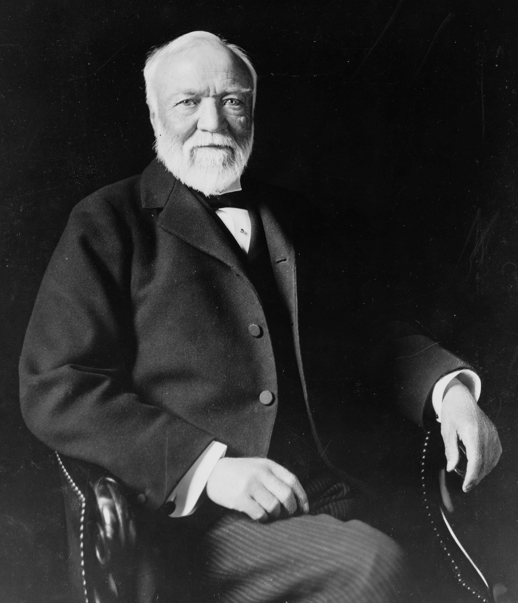
Andrew Carnegie
(Nov. 1835 – Aug. 1919)
By Carter Ward

Slide 2
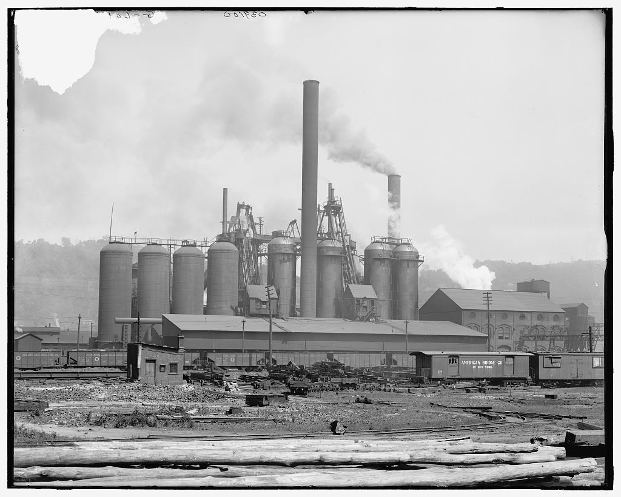
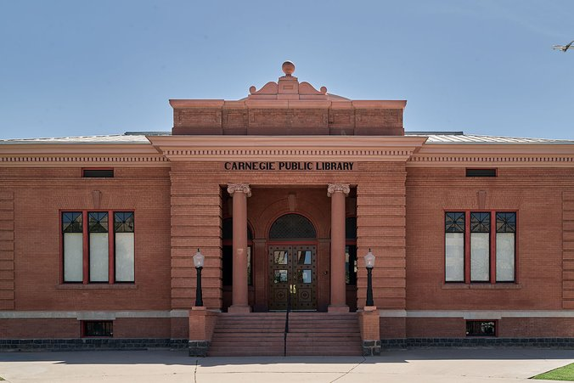
Background​
Bio
Born in Dunfermline, Scotland to a weaver family
Moved to Pittsburgh in 1848 at age 13 and began working as a bobbin boy earning $1.20/week
Advanced through telegraph work and the Pennsylvania Railroad before entering the steel industry
Sold Carnegie Steel to J.P. Morgan in 1901 for $480M and was declared the richest man in the world
Primary Profession/Source of Wealth
Industrialist who built the Carnegie Steel Corporation into the largest steel manufacturing company in the world
Held business interests in iron works, railroads, oil wells, and Great Lakes shipping by age 30
Key Causes
Public education and literacy
Higher education and scientific research
World peace and international arbitration
Support for immigrants integrating into American society
Specific Organizations Funded
Carnegie Corporation of New York (now Andrew Carnegie Foundation), Carnegie Endowment for International Peace, etc.
Mill in Pittsburgh, PA
Carnegie Public Library in South Fork, CO

Slide 3
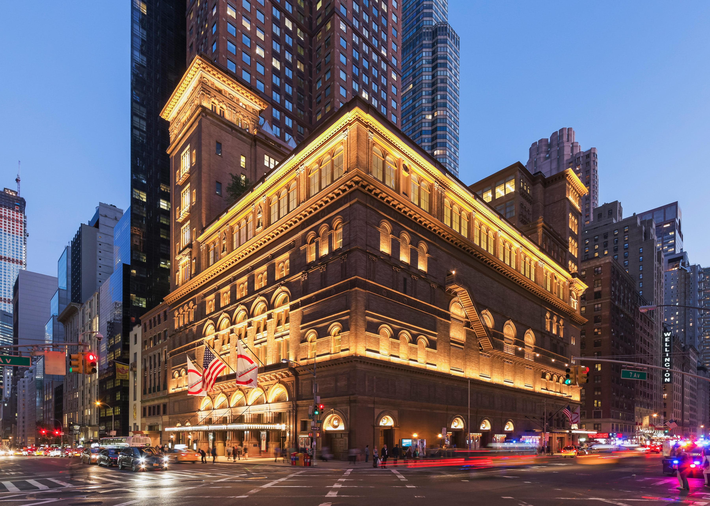

Giving vehicles
Private Foundation
Established more than 10 named foundations across education, peace, and civic causes
Carnegie Corporation of New York, founded in 1911, was endowed with $135M and was the largest philanthropic trust of its time
Key foundations include:
Carnegie Foundation for the Advancement of Teaching ($10M)
Carnegie Endowment for International Peace ($10M)
Carnegie Hero Fund Commission ($5M)
Carnegie UK ($10M)
Donor-Advised Fund
DAFs did not exist as a formal giving vehicle during Carnegie’s lifetime
Direct Giving
Personally wrote to the mayor of Pittsburgh in 1881 offering $250,000 for a free public library, later increasing the gift to $1M for a main branch and five neighborhood locations
Funded 2,509 libraries worldwide through direct grants to communities, requiring cities to provide land and operational funding
Paid for thousands of church organs across the U.S. and worldwide
Total lifetime giving reached $350M ($4.4B in 2010 dollars)
Carnegie Hall in NYC
Official Logo for the CF Adv. of Teaching

Slide 4
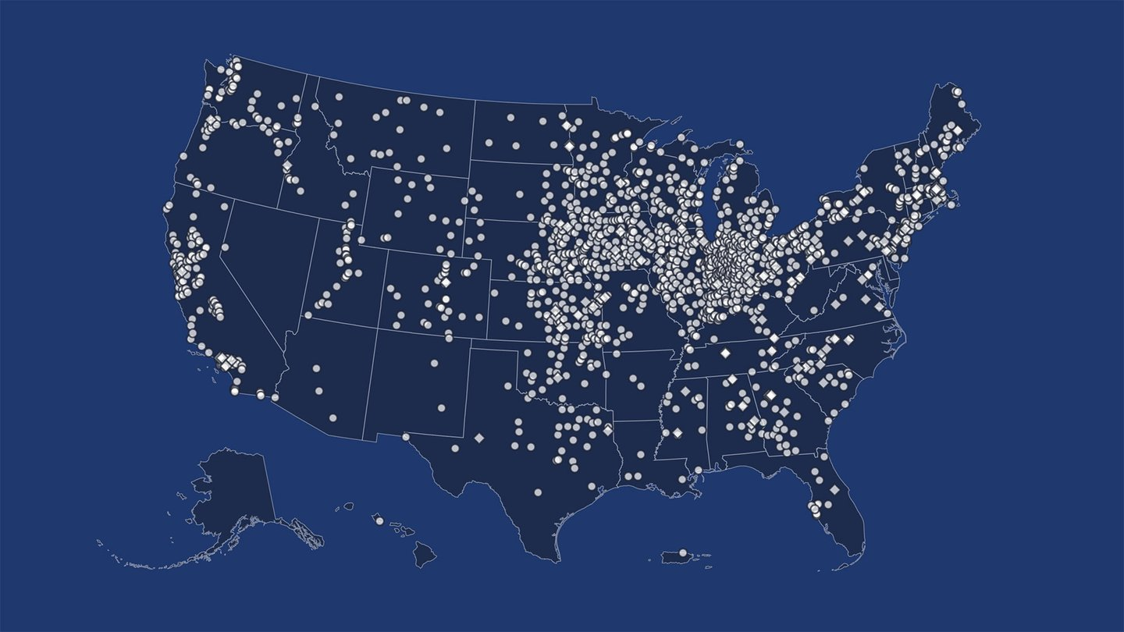
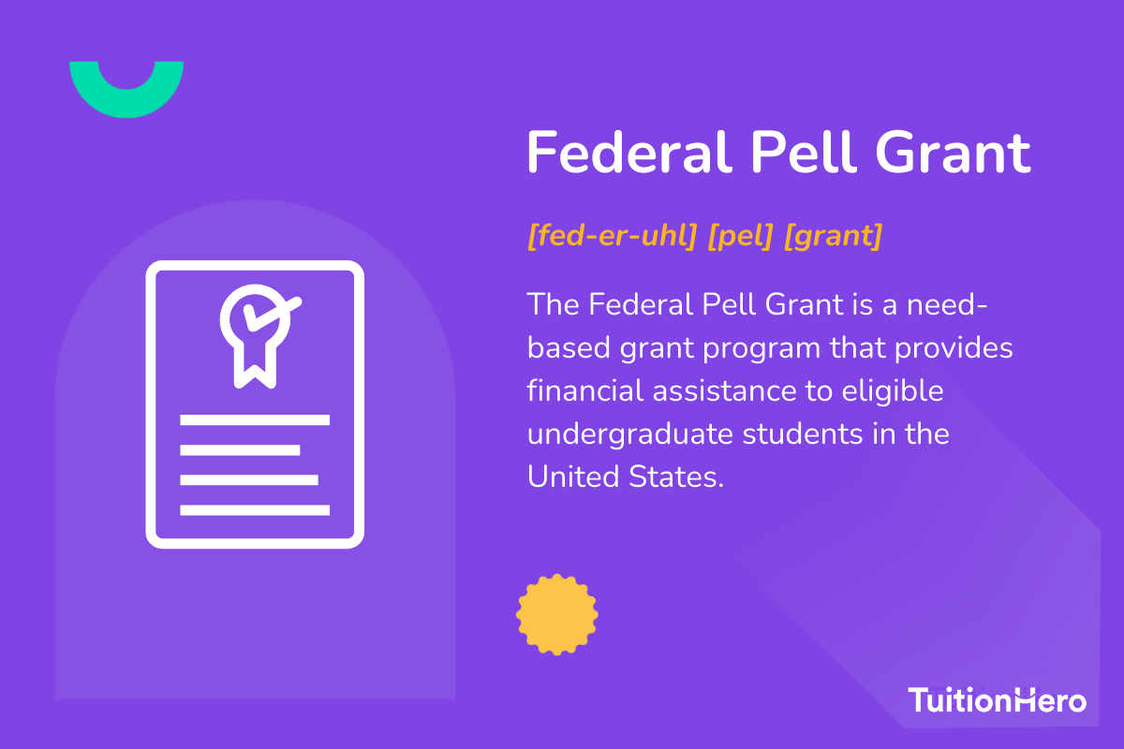
impact
Quantitative Snapshot
$350M total given away by death in 1919 (~$4.4B in 2010 dollars)
$55M+ spent on libraries alone
2,509 libraries founded worldwide
$135M endowment for Carnegie Corporation at founding
$20M+ awarded by the Carnegie Hero Fund Commission since 1904
Carnegie Mellon received $9M+ in total endowments
Qualitative Impact
Known as the "Patron Saint of Libraries" and nearly tripled public library access across America
Foundations later supported the discovery of insulin, creation of Pell Grants, dismantling of nuclear weapons, and development of Sesame Street
Carnegie Endowment became the oldest international affairs think tank and first global think tank in the U.S.
Pioneered the concept of scientific philanthropy, which focuses on strategic and results-oriented giving
Remembered for contributions to music halls, education, and libraries, with philanthropy outlasting controversies surrounding wealth accumulation
Map of Carnegie Libraries in the US
What is a Federal Pell Grant?

Slide 5
Sources
https://carnegie.org/about/andrew-carnegie-story/
https://www.pbs.org/wgbh/americanexperience/features/carnegie-biography/

